Slide 1
ML Project: Predicting Housing Prices in Ames Iowa
Team The Mean Squares (RDKS)
Radha Murali Vundavalli, Davy Brostowitz, Kranti Malviya, & Soo Hyon Lee

Slide 2
Description of the goals, the techniques to be used, and the data
How did we treat outliers, what columns needed to be dropped or combined, and what new columns were generated
What were the final models created and what were the results
Overview
Cleaning
Feature Engineering
Tests
Final Models
What data was missing, needed to be corrected, or converted
Comparing the results of the tests ran on the data and summary of what was learned

Slide 3
Overview

Slide 4
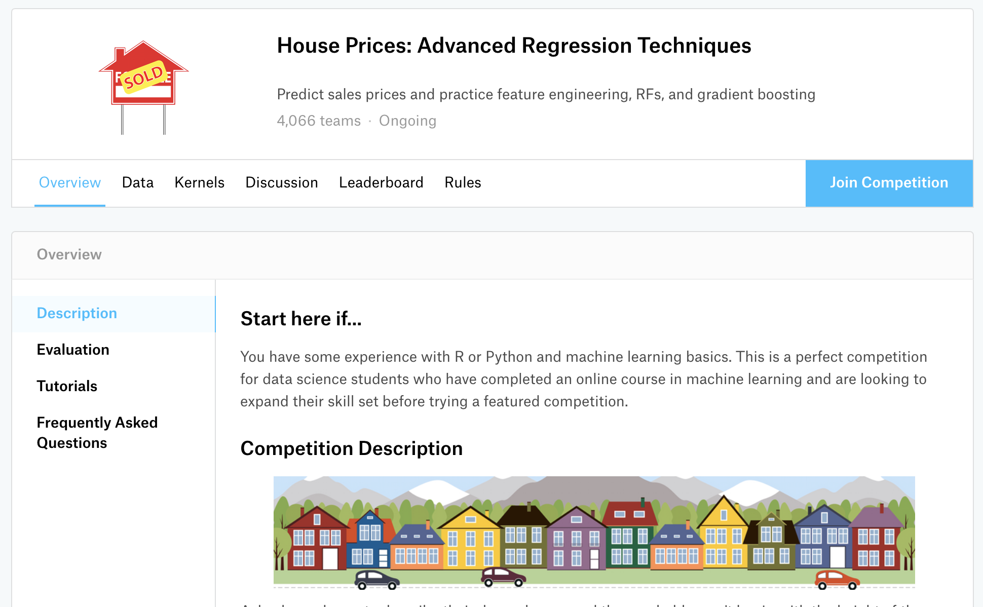
Overview:
Story/Goals
Build machine learning model to predict the sale price of homes in Ames Iowa
Optimize the accuracy of the models
Develop skills in
Data cleaning
Feature Engineering
Model development
Working in groups
Communicating process & results

Slide 5
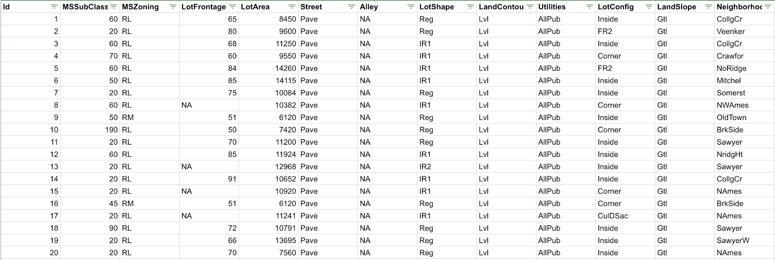
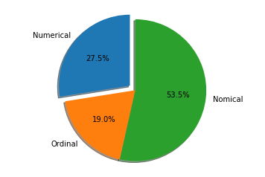
Overview:
The Data
Kaggle Housing Data Sample
The Kaggle provided training data consists of …
1460 rows
80 columns
58 categorical variables
22 numeric variables
Nominal

Slide 6
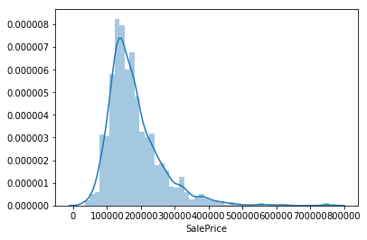
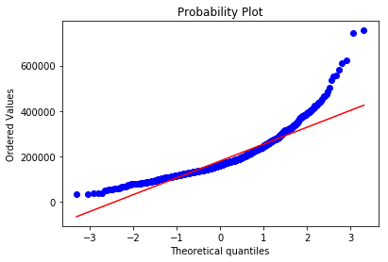
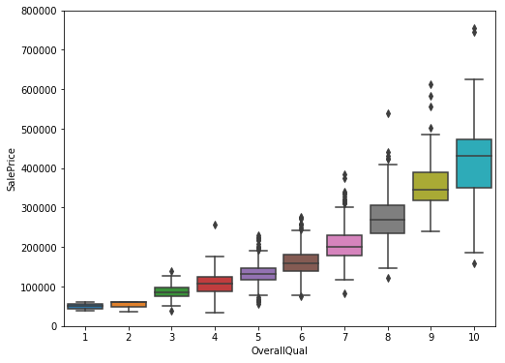
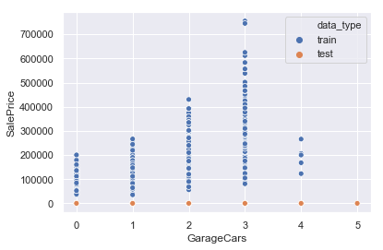
Overview:
Target Value
SalePrice
Skewness
Correlated features

Slide 7
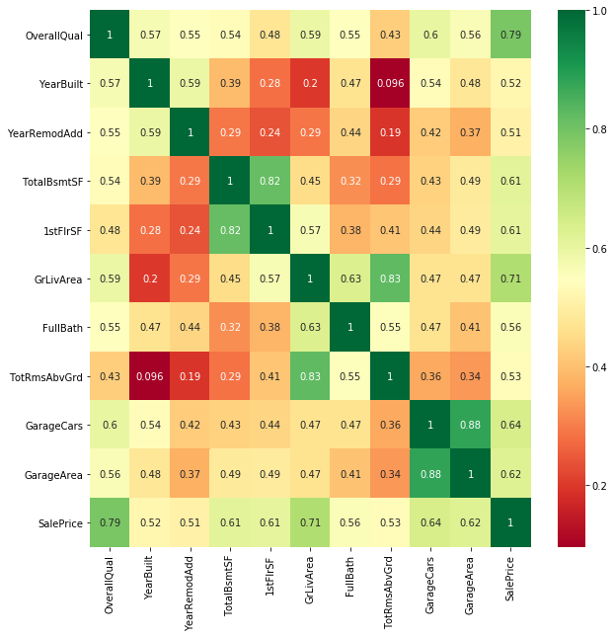
Correlation matrix:
Correlation of numerical variables with
Sale Price

Slide 8
Cleaning The Data

Slide 9
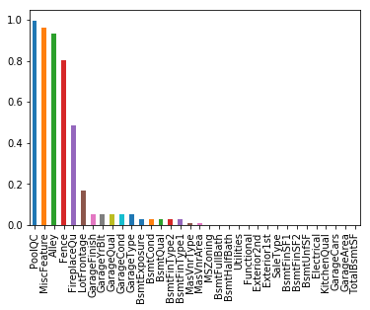
Cleaning:
Missing Values
No dataset is perfect, and the Ames housing data was no different…
How to deal with this missingness?

Slide 10
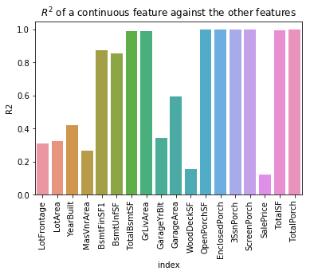
Cleaning:
Correlation/
Multicollinearity
Pearson’s Rank Correlation
Chi squared test
OverallQual 0.790982 GrLivArea 0.708624 GarageCars 0.640409
BsmtFinSF2 -0.011378 BsmtHalfBath -0.016844 YrSold -0.028923 OverallCond -0.077856 MSSubClass -0.084284 EnclosedPorch -0.128578
Utilities is NOT an important predictor. (Discard Utilities from model) LotConfig is NOT an important predictor. (Discard LotConfig from model) Neighborhood is IMPORTANT for Prediction HouseStyle is IMPORTANT for Prediction OverallQual is IMPORTANT for Prediction OverallCond is IMPORTANT for Prediction
Correlation observation
Chi squared test
Verification of importance of feature based on p-value
Multicollinearity by R^2 values
(Multicollinearity can be reduced by using Lasso regression)

Slide 11
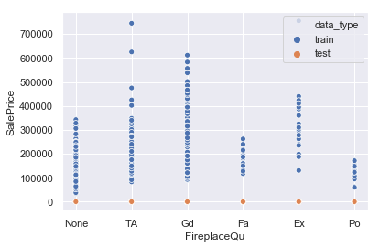
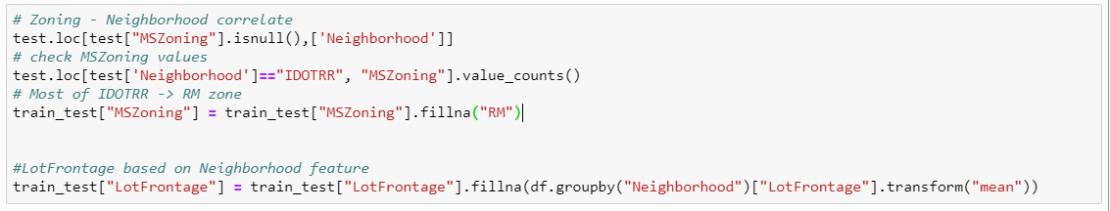
1. Simply "None"
FireplaceQual: Evaluates the height of the basement
Ex Excellent (100+ inches) Gd Good (90-99 inches) TA Typical (80-89 inches) Fa Fair (70-79 inches) Po Poor (<70 inches NA No Basement
2. Using Information from other columns
MSZoning: Identifies the general zoning classification of the sale.
A Agriculture C Commercial FV Floating Village Residential I Industrial RH Residential High Density RL Residential Low Density RP Residential Low Density Park RM Residential Medium Density

Slide 12
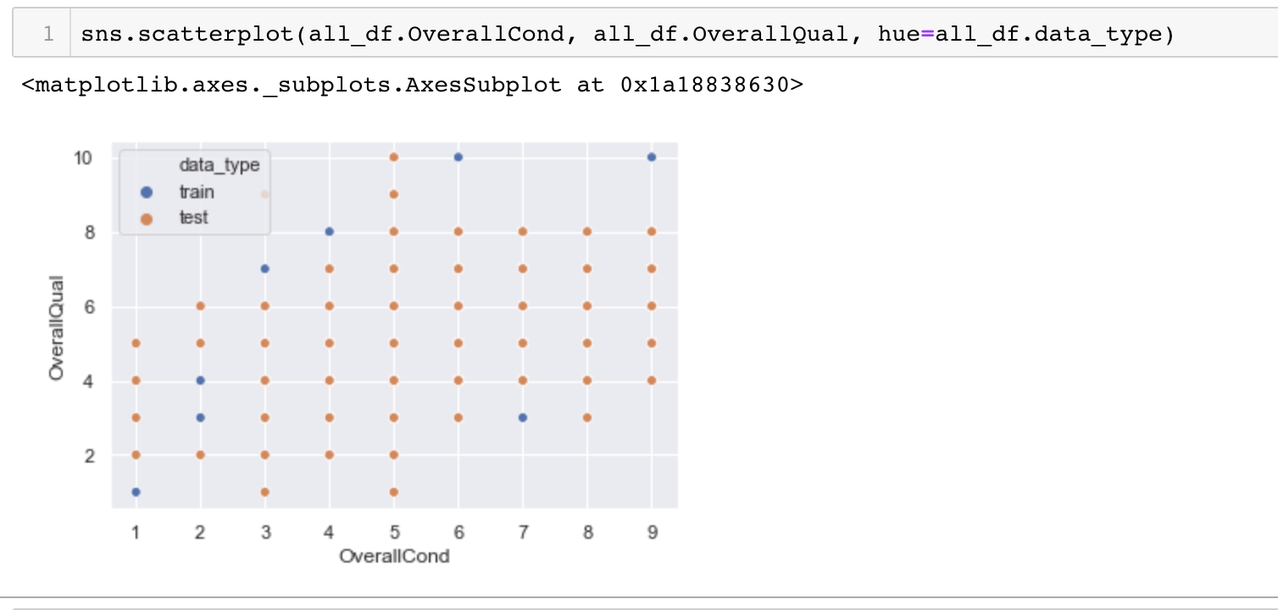
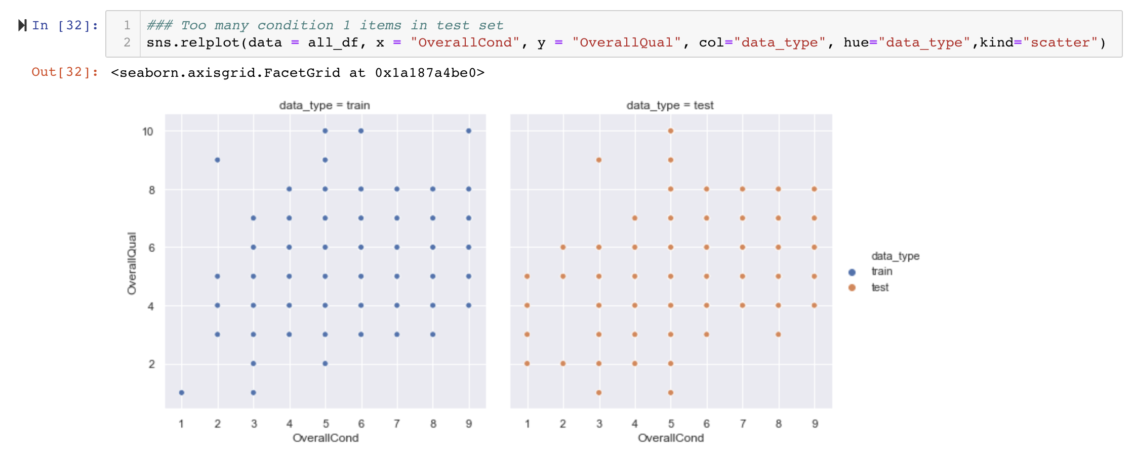
Cleaning:
Aligning Train & Test Data
In order to build a model that best predicts what should theoretically happen anomalies in the training and test data were normalized to better align with what is expected

Slide 13
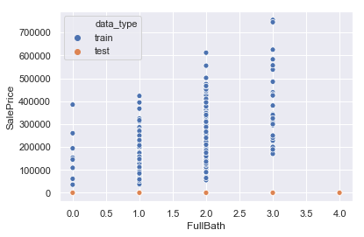
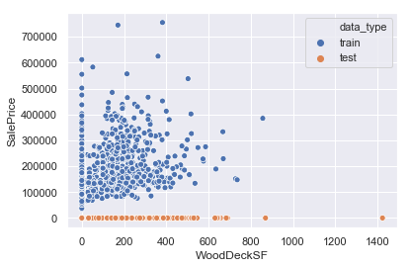
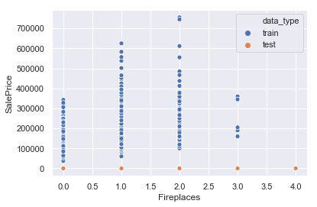
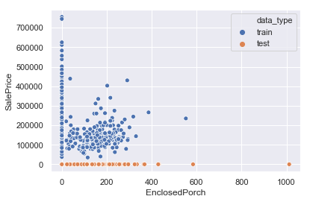

Cleaning:
Aligning Train & Test Data
Many fields have extreme values in test data that are not in train data and will have impact on prediction. (orange dot can represent multiple test records)

Slide 14
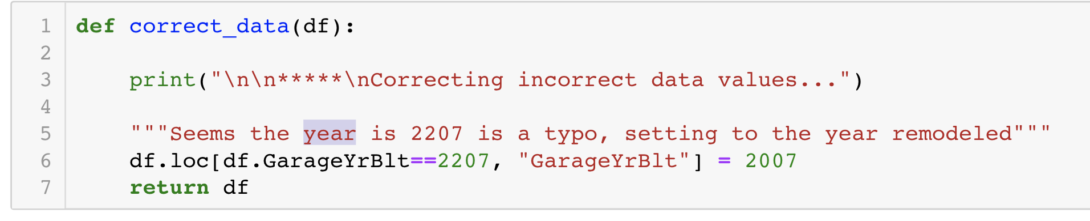
Cleaning:
Correcting
In addition to outliers and missing values, there was one point found that was clearly incorrect and so a logical value was inserted

Slide 15
Feature Engineering

Slide 16

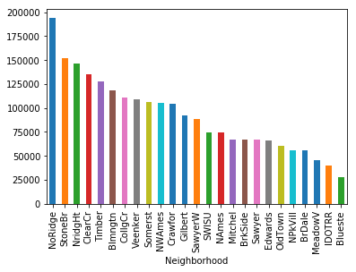

Feature Engineering
Converting
Nominal to Ordinal
Numerical or Categorical to Binary
New Columns
"HeatingQC", "KitchenQual", "FireplaceQu", "GarageQual", "GarageCond", "ExterQual” "ExterCond", "BsmtQual", "BsmtCond"...

Slide 17
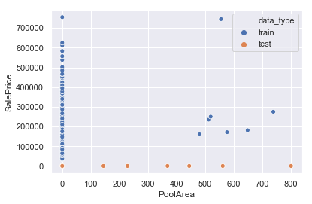
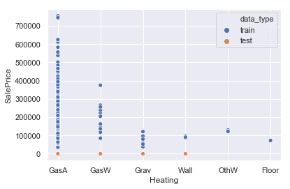
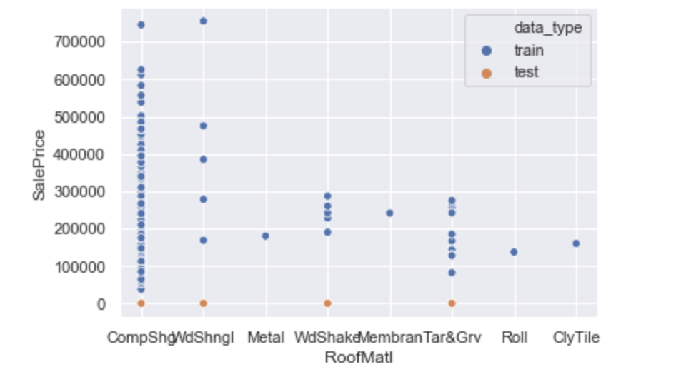
Feature Engineering
Converting
“PoolArea” -> Yes /No
Nominal to Ordinal
Numerical or Categorical to Binary
New Columns
Combined ‘Electrical’ into a binary of SBrkr and Others
Categories in "Roof Material” were changed to combine CompShngl &WdShngl and then the rest put in all others

Slide 18
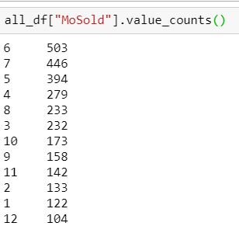
Feature Engineering:
Combine features
Brand New House
YearSold == YearBuilt
Remodelled or Not
High Season
Nominal to Ordinal
Numerical&Categorical to Binary
New Features
Total Bath, TotalSF,
Age of building,
Season,
Porch or not…..
Remodadd != YearBuilt
Total Baths
Full Bath + Half Bath

Slide 19
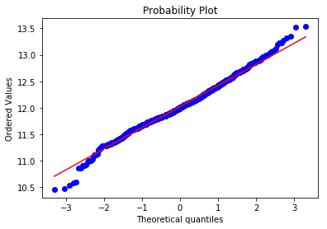
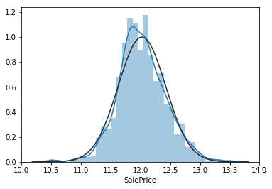
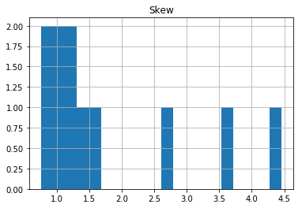
Feature Engineering:
Skewness
Skew in numerical features: Skew LotArea 4.459077 TotalArea 3.600242 MasVnrArea 2.613592 TotalSF 1.511479 MSSubClass 1.375457 GrLivArea 1.269358 TotalBsmtSF 1.156894 BsmtFinSF1 1.120355 SalePrice 1.098792 BsmtUnfSF 0.919339 TotRmsAbvGrd 0.758367 LotFrontage 0.676851 Age 0.599806 GarageArea 0.239257
Transform the skewed numeric features by taking log(x+ 1)

Slide 20
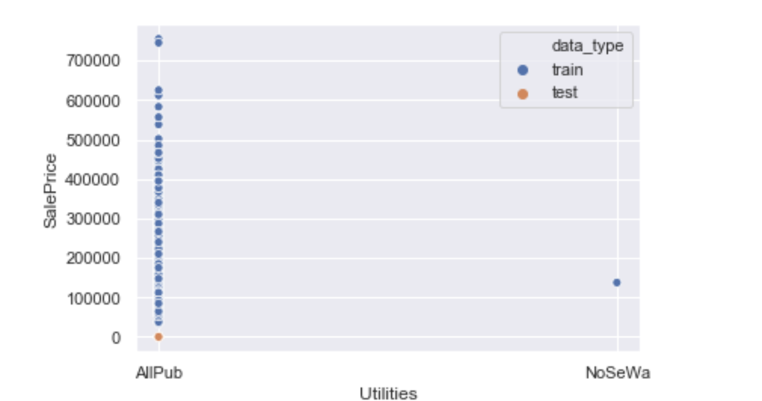
Feature Engineering:
Dropped Columns
Variables that added too much unnecessary complexity or added to little value were removed from the model
Columns Dropped
Street
Utilities
2ndFlrSF(replace 2ndFoor Y/N)
LowQualFin
PoolQC (replaced with a Pool Y/N column)
MiscValue

Slide 21
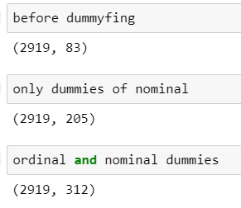
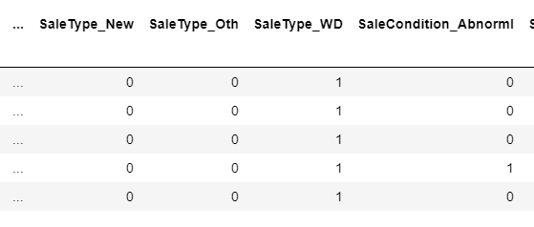
Feature Engineering:
Create Dummies

Slide 22
Tests

Slide 23
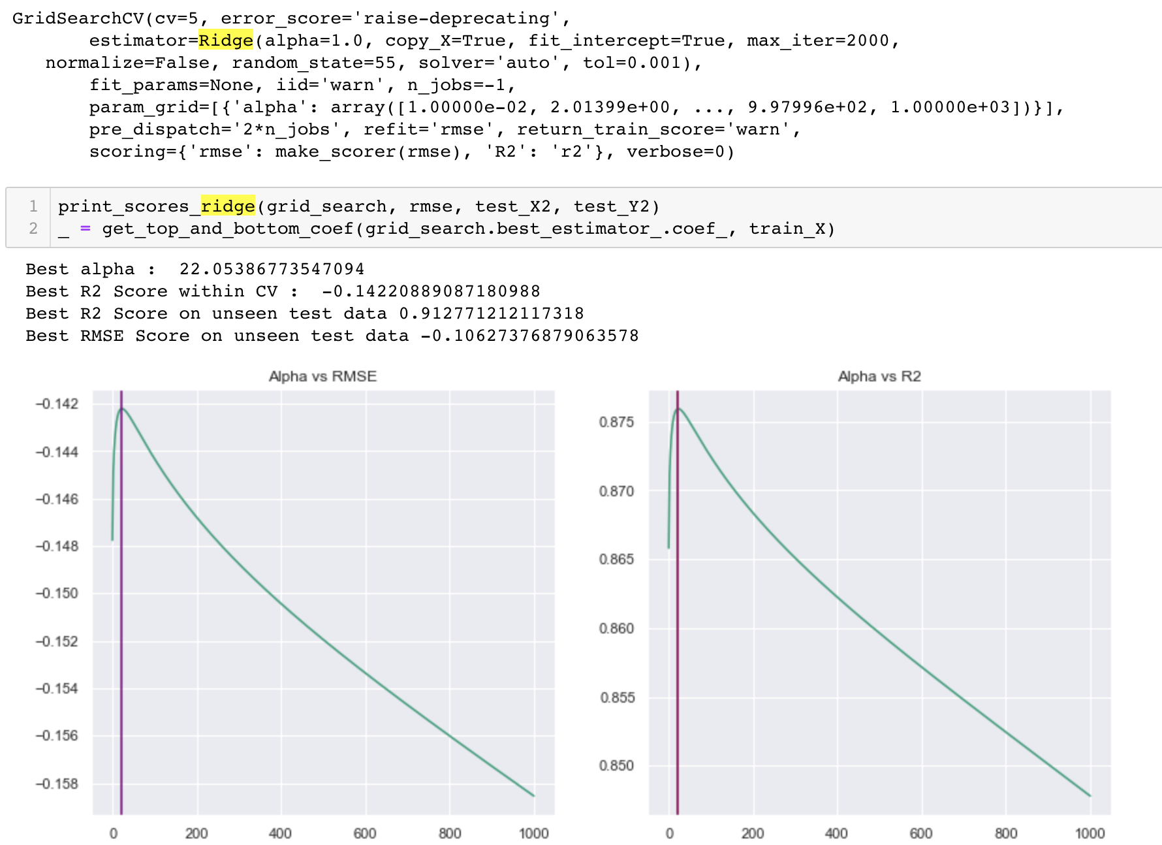
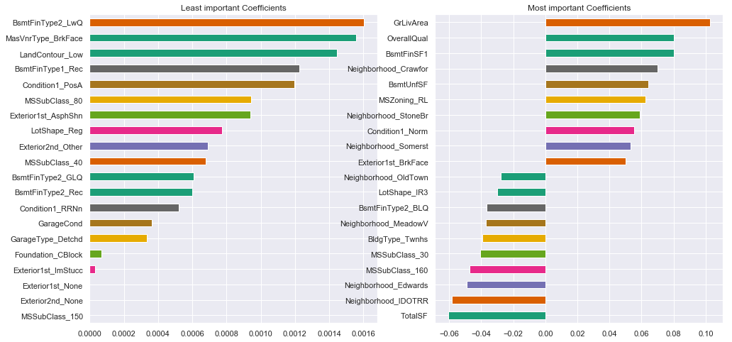
Tests:
Ridge with Log(Y)
Using GridSearch

Slide 24
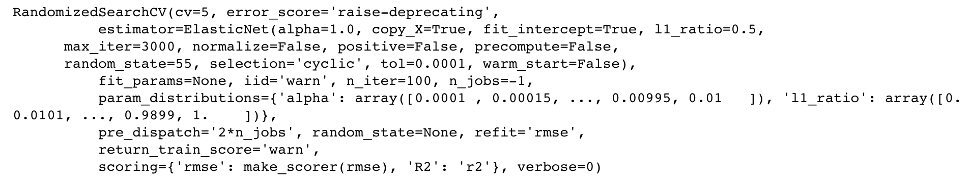
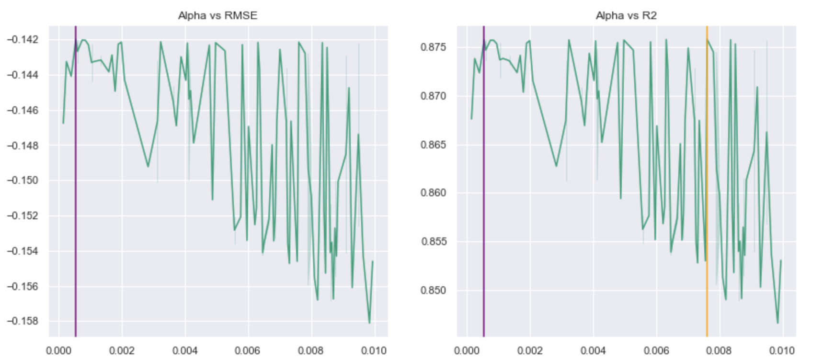
Tests:
Elastic Net with log(y)
Using RandomizedSearchCV

Slide 25
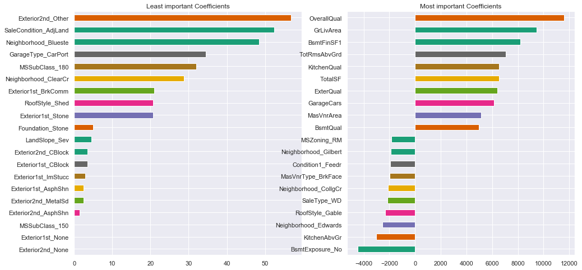
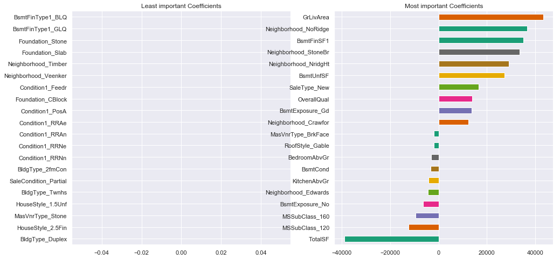
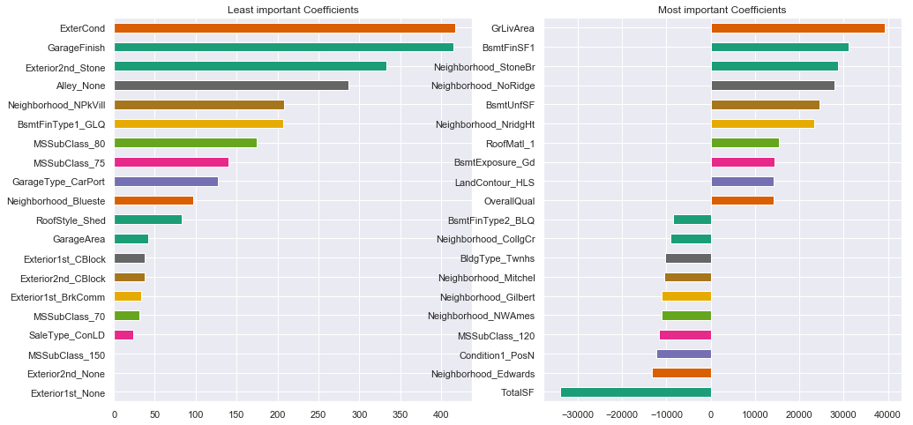
Tests:
Best and Worst Predictors by Test Type
Ridge
Lasso
Bayes Ridge

Slide 26
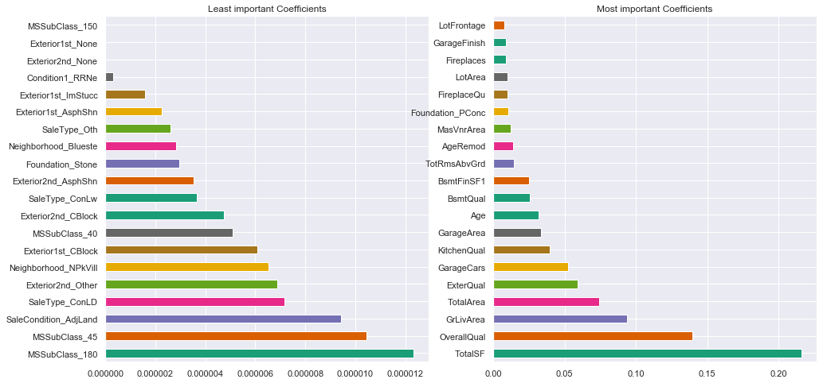
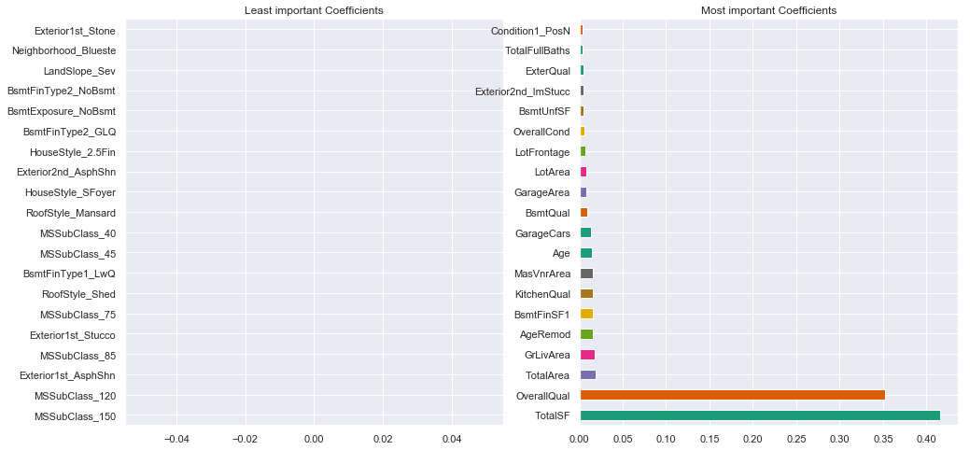
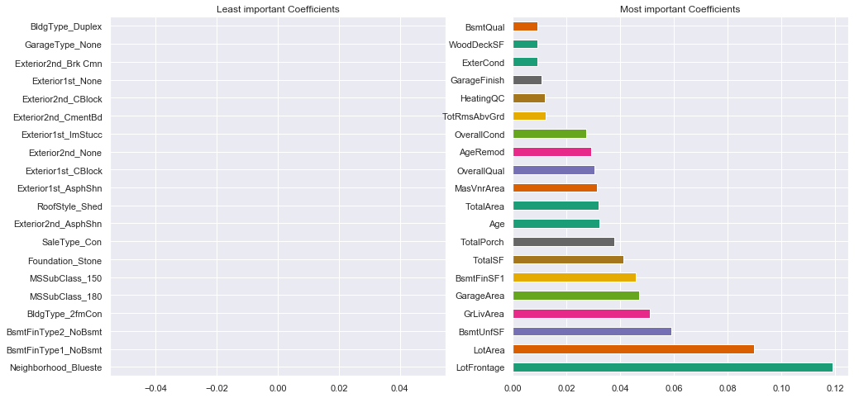
Tests:
Best and Worst Predictors by Test Type
Random Forest
Gradient Boost
XGB

Slide 27
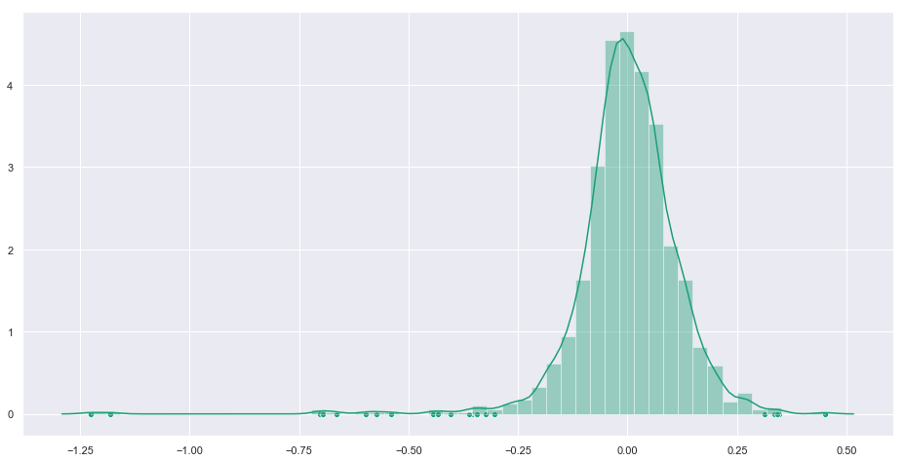
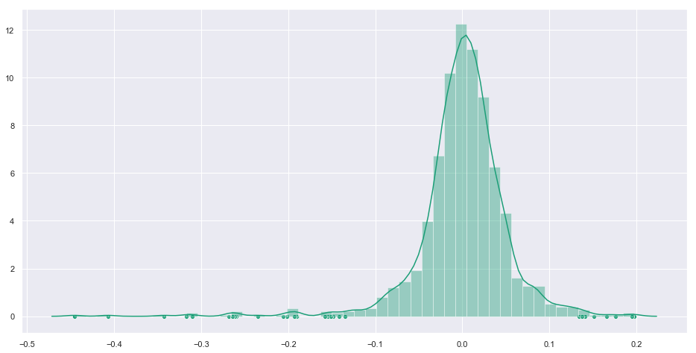
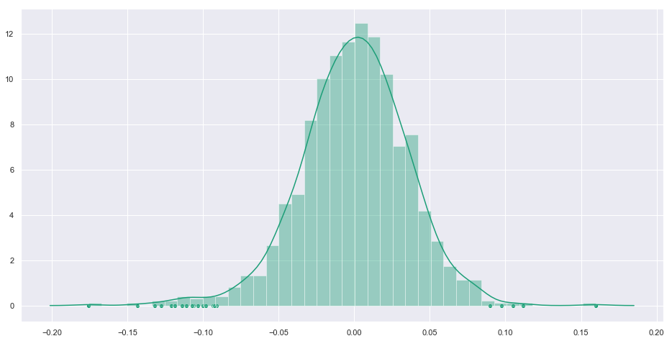
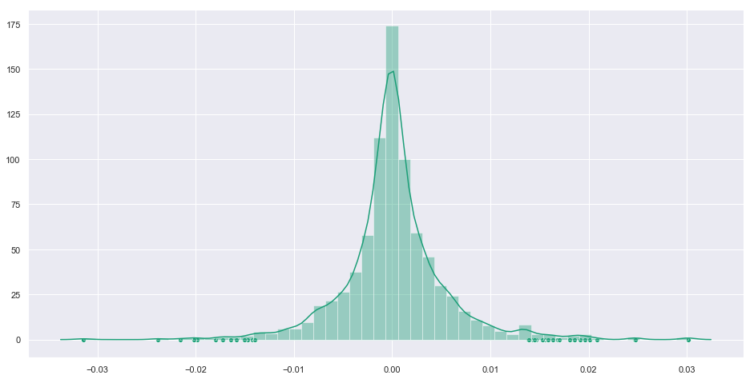
Tests:
Outliers by Test Type
Ridge Log (y)
Random Forest Log (y)
Outliers that are 2.5 standard deviations away
Gradient Boost Log (y)
XGB Log (y)

Slide 28
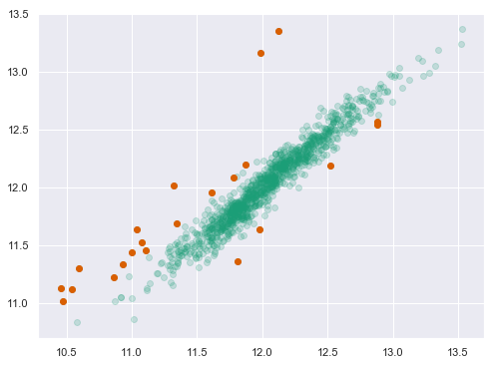
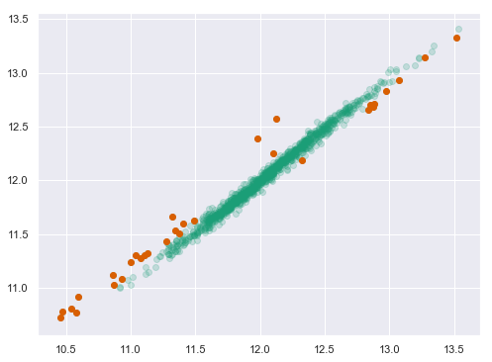
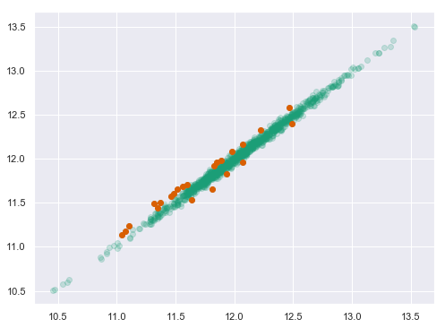
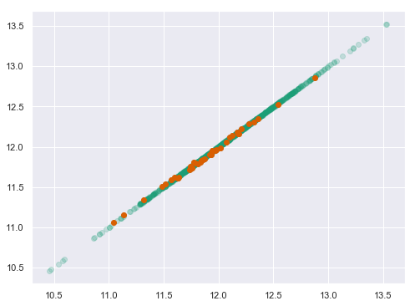
Tests:
Outliers by Test Type
Ridge Log (y)
Random Forest Log (y)
Different view
Gradient Boost Log (y)
XGB Log (y)

Slide 29
Results

Slide 30
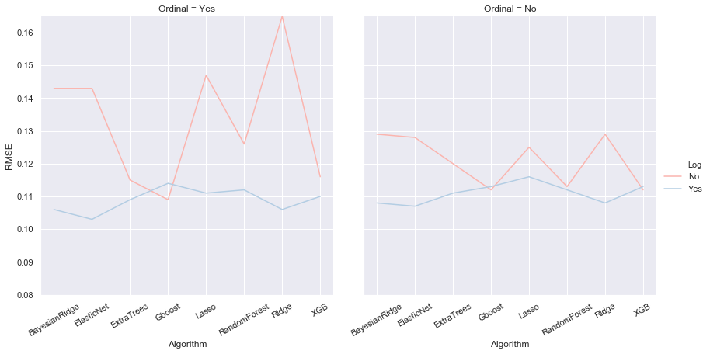
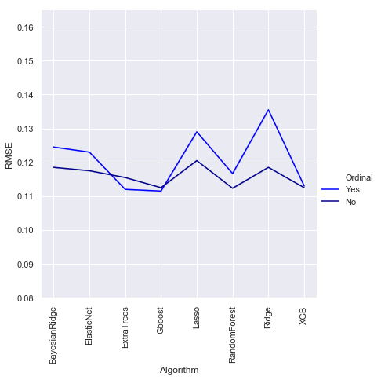
Results:
Log and Ordinal Changes Impact on CPU, RSME, & R^2
R^2
R^2 improved with log transformation
Ordinal conversion worsened R^2, except for GBoost and ExtraTrees

Slide 31


Results:
Log and Ordinal Changes Impact on CPU, RSME, & R^2
RSME
RMSE improved with log transformation
Mixed bag with ordinal, but not much difference

Slide 32

Results:
Log and Ordinal Changes Impact on CPU, RSME, & R^2
CPU
Bayesian Ridge is the best of models we tried in all aspects, except Kaggle Score

Slide 33
Other Observation
Metrics module helped fit and track for log RMSE
GridSearch can be used to optimize for metric when the estimator used does not accept custom metric
RandomizedSearchCV helped with runtimes
Interactions terms seem to be improving the results, but takes long to converge (to explore further)
Mean Stacking helped a little bit
Refit with all data, as train data is limited, helped a bit (to explore further)
Save the best estimators to save time and refit if needed
Write Functions, Jupyter Notebooks notebooks waste lot of time beyond initial EDA

Slide 34


Final Scores
Ridge score on training set: 0.11299
Lasso score on training set: 0.1113
elaNEt score on training set: 0.11116
Random Forest score on training set: 0.190624
GBoost score on training set: 0.113549
XGBoost score on training set: 0.11307
svr score on training set: 0.11181

Slide 35
Questions

